Slide 1
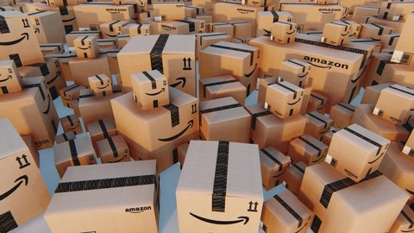

Amazon Delivery: Environmental Impact Analysis (PESTEL Framework)
Shraddha Ginoya (NF1015893),
Rushil Jani (NF1007181)
Nkem Iwuajoku NF1006663
Group 9, DAMO-511-5,
Prof. Omar Nada

Slide 2
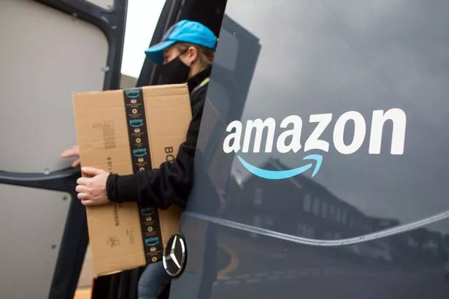

Introduction
Amazon’s last-mile delivery operations face significant challenges from external and internal factors.
This project provides an environmental impact analysis of Amazon’s delivery services using the PESTEL framework (Political, Economic, Social, Technological, Environmental, and Legal).
By analyzing more than 39,000 real-world deliveries from the Kaggle dataset, we applied advanced analytics—including regression, hypothesis testing, and dashboard visualization—to identify key risks and opportunities.
The findings highlight how evolving factors such as weather, distance, and agent performance affect operational efficiency, customer satisfaction, and strategic planning for Amazon’s logistics business.
.

Slide 3

Methodology & Data Handling
Data Source: Kaggle (Amazon Delivery Variables: Delivery time, weather, distance, traffic, agent info, area, etc.
Dataset, 39,365 records post-cleaning).
Cleaning Steps: Handle missing values, outlier detection, column standardization, duplicate removal.
Mapped variables to PESTEL for robust multi-factor analysis.

Slide 4



Analysis Techniques
Multiple Linear Regression: Delivery Time ~ Distance + Weather + Traffic
Trend & Time Series Analysis: Delivery patterns by day/month.
Outlier/Anomaly Detection: Boxplots, speed/time flags.
Hypothesis Testing: Mann-Whitney U for weather’s impact on delivery time.

Slide 5
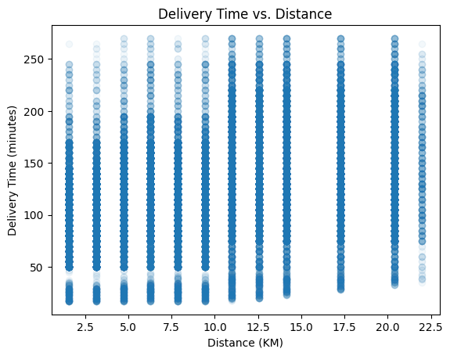
Multiple Linear Regression: Predicting Amazon Delivery Time
Objective: Predict delivery time using distance, weather, and traffic as predictors (n = 39,365 orders).
Regression Model: Delivery Time = 121.29 + 2.67 × Distance – 4.54 × Weather – 11.83 × Traffic
Key Findings:
Distance: Each additional km increases delivery time by ~2.67 minutes (p < .001).
Weather: Adverse weather significantly delays deliveries (p < .001).
Traffic: Higher traffic levels also increase delivery time (p < .001).
R²: 0.15 (15% of variation explained by model).
Strategic Insight: Distance, weather, and traffic are major drivers of delays. Optimizing routes and proactively managing weather and traffic can improve Amazon’s delivery efficiency.

Slide 6
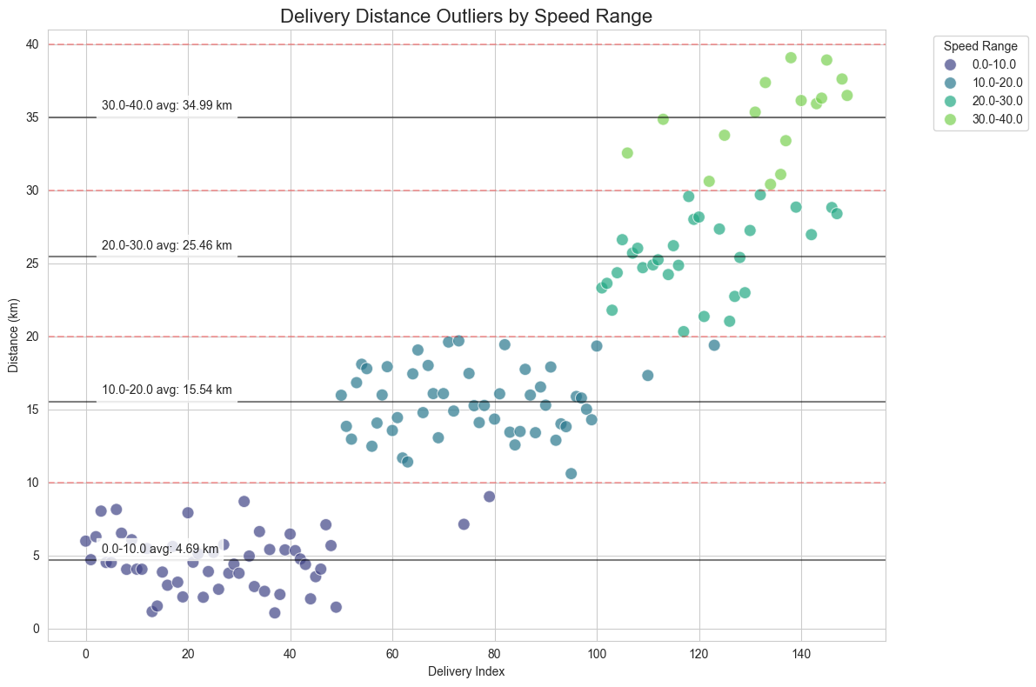
Finding correlation between speed
And distance: Analytic for operational insights
Objective: The chart categorizes delivery distances based on average speed ranges (e.g., 0–10 km/h, 10–20 km/h, etc.).
Scatter Plot: Each color represents a different speed range. Distance Trends:The trend indicates that as the average speed increases, the delivery distances also tend to increase. This suggests that faster deliveries are associated with longer distances, which could point to operational efficiency in certain scenarios.
Strategic Insight: The lustering of delivery distances suggests that specific speed ranges may be associated with varying levels of operational efficiency. Focusing on improving performance in lower speed ranges could lead to substantial gains in the delivery efficiency.

Slide 7
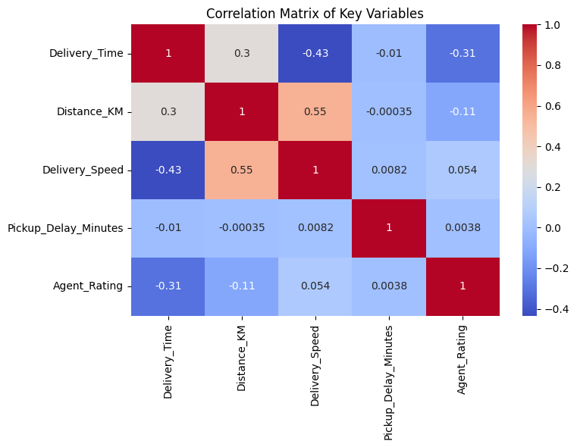
Optimizing Delivery Operations: Key Correlations in Amazon's Performance Metrics
Objective: objective is to analyze the correlations among key delivery performance metrics at Amazon, identifying relationships between delivery time, distance, speed, and agent ratings
Correlation Matrix: Strategic Insight:
The correlation matrix reveals key relationships among delivery performance metrics for Amazon. Delivery Time and Distance (0.3):
A significant negative correlation suggests that higher delivery speeds result in shorter delivery times.
This reinforces the importance of improving speed for operational effectiveness
Agent Rating and Delivery Time (-0.31): The negative correlation indicates that higher agent ratings are associated with shorter delivery times, emphasizing the need for agent training and support to enhance performance.
By leveraging these insights, Amazon can prioritize route optimization, invest in agent development, and focus on improving delivery speeds, ultimately enhancing customer satisfaction and operational efficiency.

Slide 8

Hypothesis Test (Weather Impact)
01
02
03
Procedure & Results:
Normal Weather: ‘Clear’, ‘Sunny’ (n = 7,078), Mean = 103.66 min
Adverse Weather: All other conditions (n = 36,661), Mean = 129.01 min
Mean difference: +25.34 min
Mann-Whitney U: U = 89,196,435, p < 0.001
Hypotheses:
Null (H₀): No significant difference in average delivery time under normal vs. bad weather.
Alternative (H₁): Average delivery time is significantly higher during bad weather.
Test Selection:
Delivery time data is not normally distributed (Shapiro-Wilk, p < .05).
Variance is unequal (Levene’s, p < .05).
Used Mann-Whitney U test (nonparametric) to compare groups.
Reject H₀: Average delivery time is significantly higher during bad weather

Slide 9
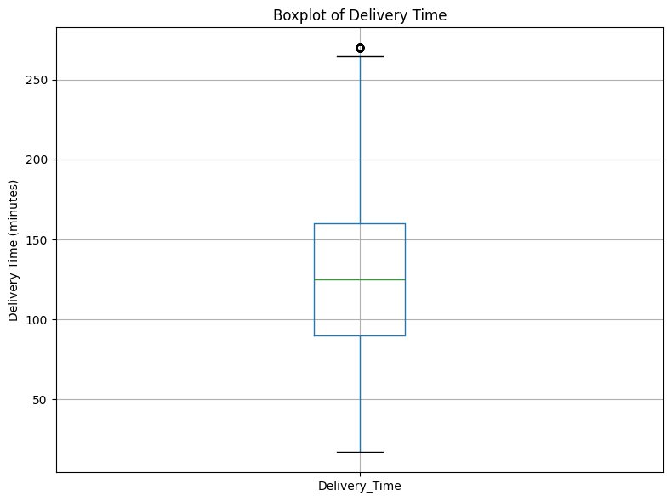
Box Plot
Box: Shows the normal range (middle 50%) of delivery times.
Median line: Marks the typical (middle) delivery time.
Whiskers: Indicate most delivery times within expected limits.
Dots: Highlight outliers—unusually fast or slow deliveries.
Why it matters: Quickly spot trends, variation, and delays in delivery performance.

Slide 10
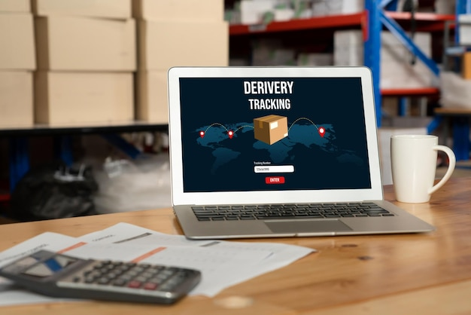

Weather is a major, quantifiable risk
Distance increases cost & delay
Demand patterns require workforce flexibility
Tech upgrades minimize delay outliers
Focus needed on sustainability and compliance
Key Insights

Slide 11

Strategic Recommendations
Real-time weather & traffic analytics
Advanced route and workforce optimization
Predictive demand planning
Focused agent training and support
Sustainable, tech-enabled logistics

Slide 12

Conclusion
Amazon’s last-mile delivery performance is strongly affected by PESTEL factors—especially weather, distance, and traffic.
Advanced analytics (regression & hypothesis testing) showed that adverse weather adds, on average, 25 minutes to delivery times.
Data-driven decision-making is essential for identifying risks and optimizing logistics.
Strategic actions:
Invest in predictive analytics and weather routing
Optimize routes and resource planning
Embrace technology upgrades and sustainability
These strategies will enhance service reliability, efficiency, and customer satisfaction—solidifying Amazon’s leadership in innovative delivery solutions.

Slide 13
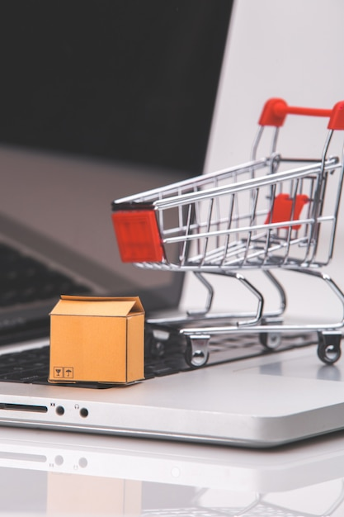
Thank You…

